Slide 1

Grow Mate
Projeto em Informática – Sensing My Home
Licenciatura em Engenharia Informática
Apresentação Final
Grupo 5
06/06/2023

Slide 2

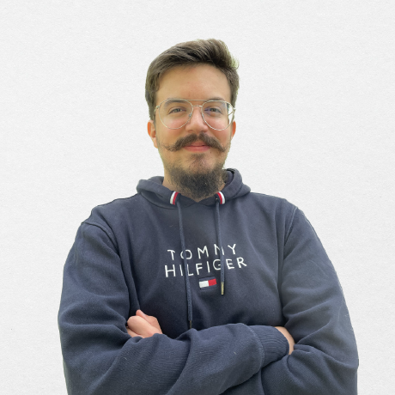
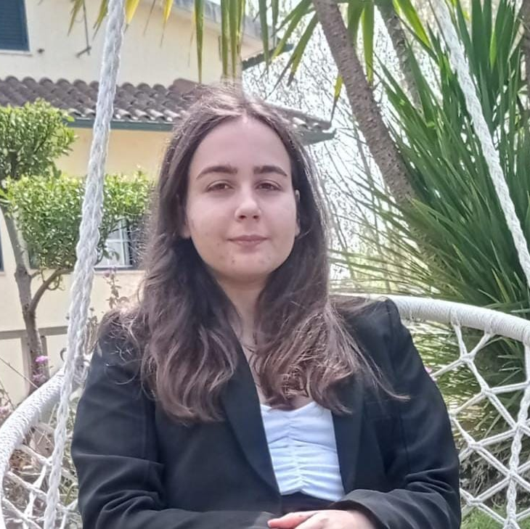

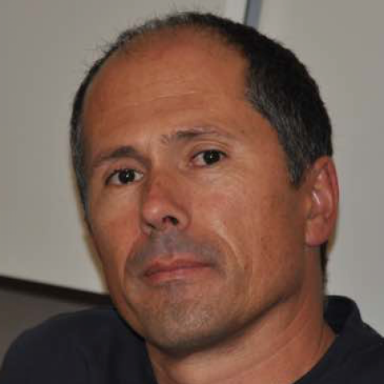
The Team
Artur Correia
André Butuc
Bruna Simões
Daniel Carvalho
José Luís Oliveira
(Advisor)
1

Slide 3
Context & Requirements Gathering

Slide 4
Context & Problem
Demand for ingrown plants during the last 3 years rose by 18%.
Difficulty for new plant owner to attend to all their specific plant's necessities.
Advances in technology allowed systems' creation that helped users attending their plant's needs.
Each species has its own specific needs.
Low experience can cause heightened plant mortality rate.
Daily life's demands can cause users to forget about plant's needs.
Finding new plant species can be a search-intensive and boring task.
3

Slide 5
Goals & Solution
Facilitate plant's acclimatization process.
Provide tasks for each plant.
Suggestion of similar plants.
Sensors which capture different plant parameters.
Implementation of a mobile application for home plant management.
4

Slide 6
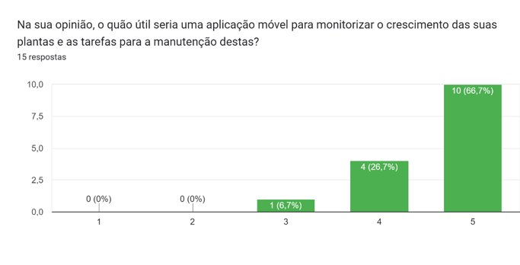
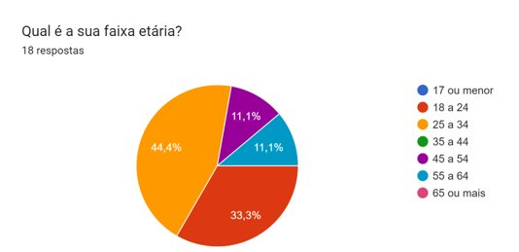
Questionnaire & Interviews
5

Slide 7

Actors
User with premium account
User without account
User with account
6

Slide 8
Functional Requirements
All Users
Full catalogue of plants available in the database
House Plants Inventory and Management
All
Registered Users
Suggestion of optimal conditions for each plant
Scheduling of tasks for plant maintenance
7

Slide 9
Functional Requirements
Business Rules
All
Registered Users
Suggestion of new plants to grow
Division implementation
Plant condition presented in a traffic light system
Premium Users
Only
Integration with measurements provided by sensors
8

Slide 10
Architecture & Deployment

Slide 11
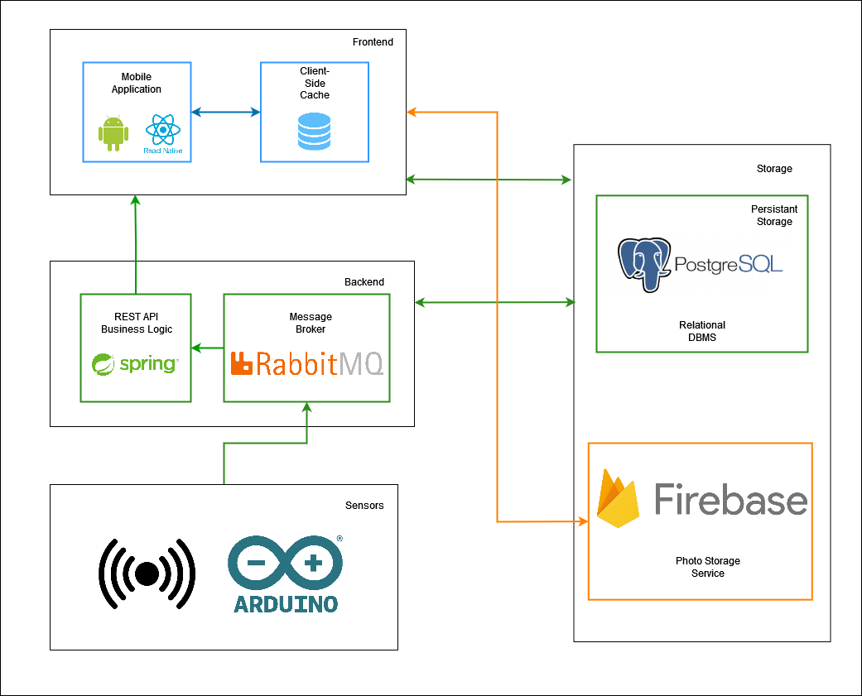
Architecture Diagram
10

Slide 12
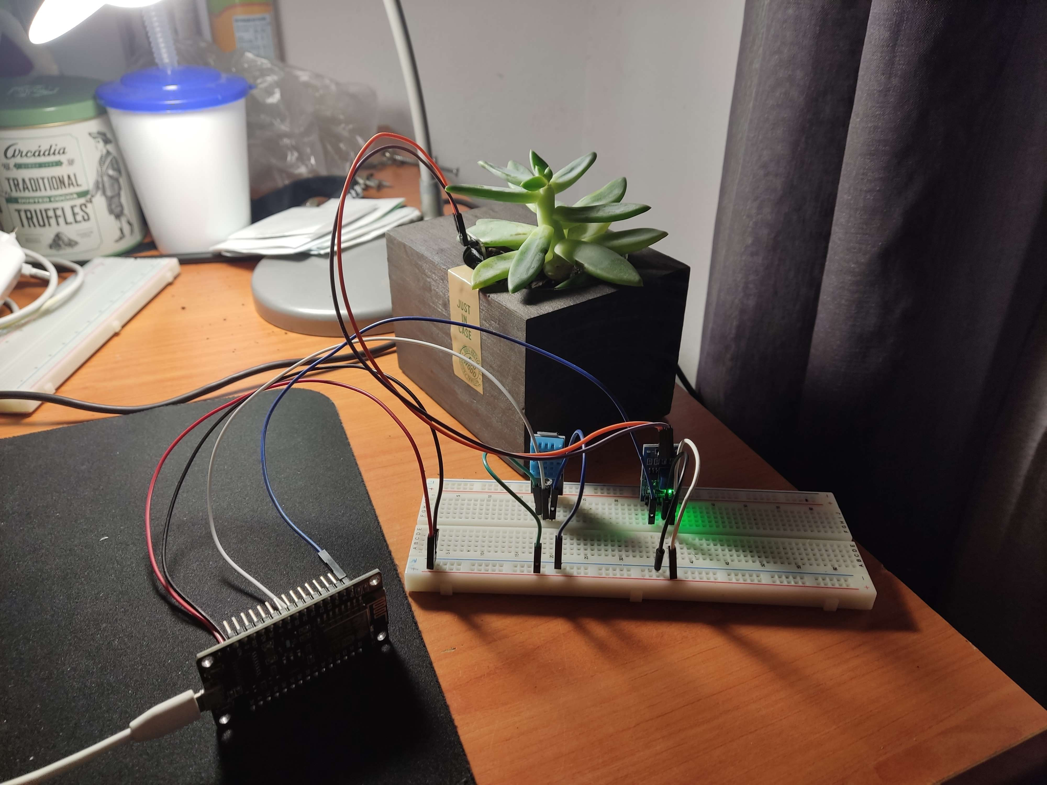
Sensors Integration
DHT11 (Air Temperature + Humidity)
Resistive Soil Moisture Sensor
ESP8266
11

Slide 13
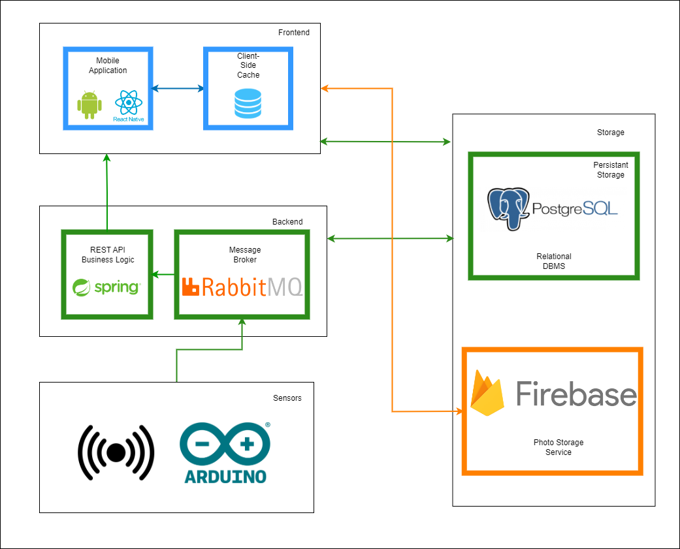
Deployment
Expo Application Services – Generated APK
Azure VM
Firebase Cloud Services
12

Slide 14
Development

Slide 15
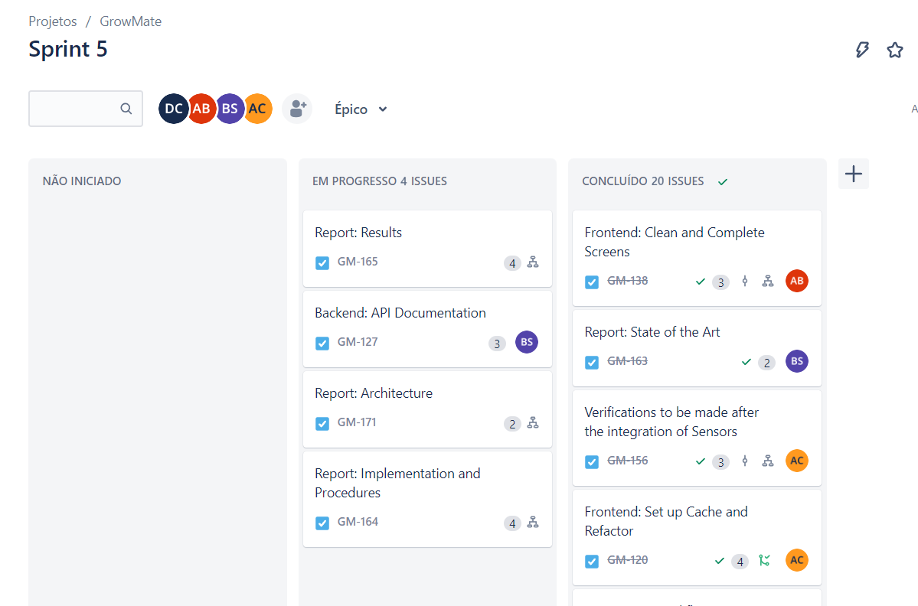
Backlog Management
1-3 week long Sprints, achieving an incremental development of the product
Sprint planning meeting for task distribution
Weekly checkpoints between the team members, and biweekly meetings with the supervisor
14

Slide 16



Development Tools
Jira
Agile backlog management for planning and task tracking
Discord
Private server for team communication and organization
OneDrive
Sharing of internal documents
15

Slide 17

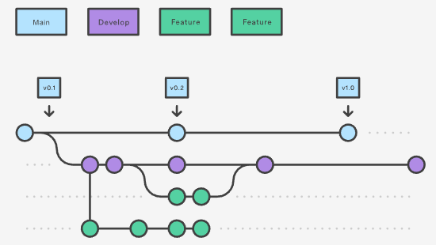
Git Workflow
Use of an adapted Git Feature branch workflow:
A branch for each main feature
A integration branch for Frontend and Backend
Dev branch for integration
Main branch for releases
16

Slide 18
Project Calendar
Milestone 1
Presentation of the lifecycle objectives and calendar for the project
Milestone 2
Presentation of the lifecycle architecture
Milestone 3
Protoype; Mid-Term Presentation
Milestone 4
Project Presentation
Milestone 3.1
Milestone 4.1
28/02
14/03
11/04
30/05
24/03
01/05
MARCH
APRIL
MAY
Integration of additional features
Deployment infrastructure stabilization
Defining core user stories
Non-Functional UI prototypes
Database
Modellling
API and backend stabilization
Final development of the UI
Developing the remaining user stores
Finalizing functional and non-functional requirement analysis
Determining which sensors to integrate in the system
Defining the problem domain
UI Development based on the main core user stories
Sensor data generation and integration basic pipeline
Core user stories implemented for the demonstration of the full-stack architecture
17
Notes:
No início do projeto, para nos organizarmos de forma a otimizar o tempo disponível, construímos um calendário onde estipulávamos as principais tarefas que iríamos realizar em cada milestone do projeto. [click] Felizmente fomos capazes de acompanhar este calendário até ao Milestone 4.1, onde tivemos que re-adaptar algumas componentes do mesmo e aplicar o plano de gestão de riscos que tínhamos definido. [click] Desta forma, descartámos a implementação de funcionalidades adicionais e estendemos as tarefas de estabilizar o frontend e backend que acabaram por demorar mais tempo do que estávamos à espera.

Slide 19
Feedback & Refactor
Refactor of:
Task Scheduling Logic and Design
Sensor Inventory Page Design
Milestone 3
Feedback
18
Notes:
Uma das principais razões por nos termos atrasado, [click] foi o facto de termos recebido feedback após o Milestone 3 que levou a um refactor da lógica de calendarização das tarefas e da alteração do design de algumas secções da aplicação.

Slide 20
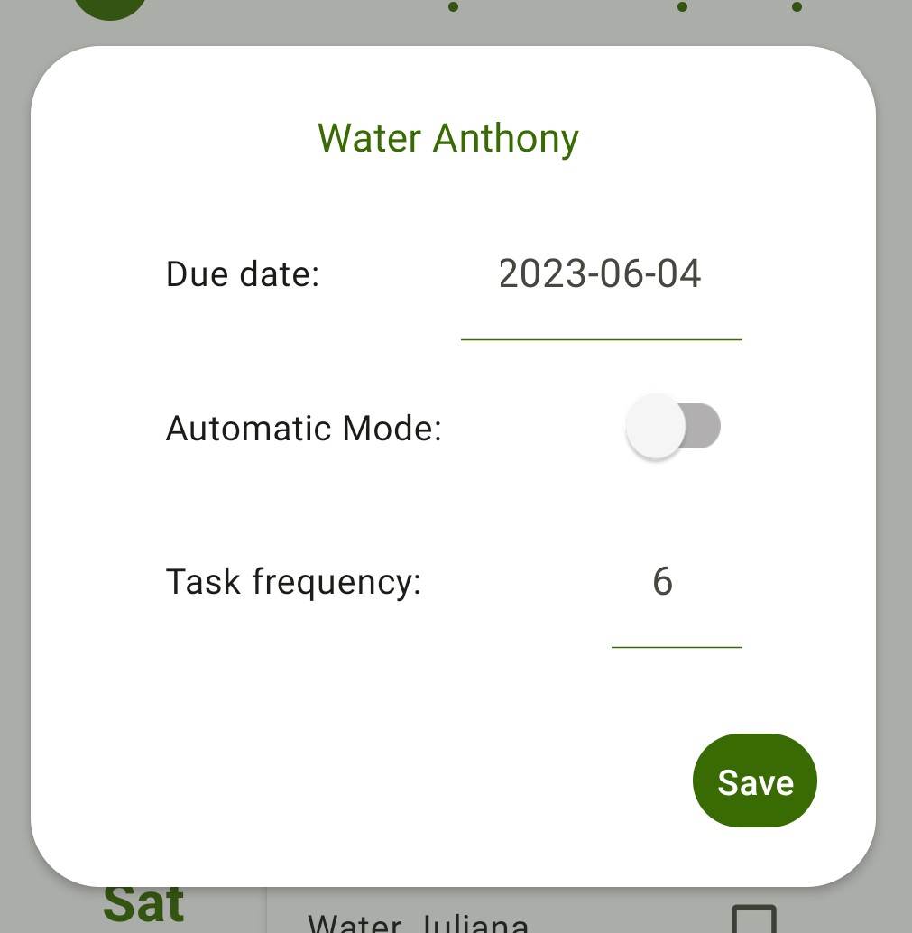
Feedback & Refactor
Task Scheduling
Problem:
Solution
Fixed due date;
Fixed frequency;
Not flexible
19
Notes:
Inicialmente, tínhamos definido um conjunto de tarefas fixas, por exemplo, “Regar a planta X” ou “Fertilizar a planta Y”, [click] que tinham uma data de finalização e frequência pré-definidas, não podendo estas serem alteradas. No entanto, modificámos a funcionalidade para se tornar mais flexível e possibilitar ao utilizador alterar a data de finalização ou até mesmo a frequência da tarefa, podendo assim fazer uma gestão mais personalizada das mesmas.

Slide 21
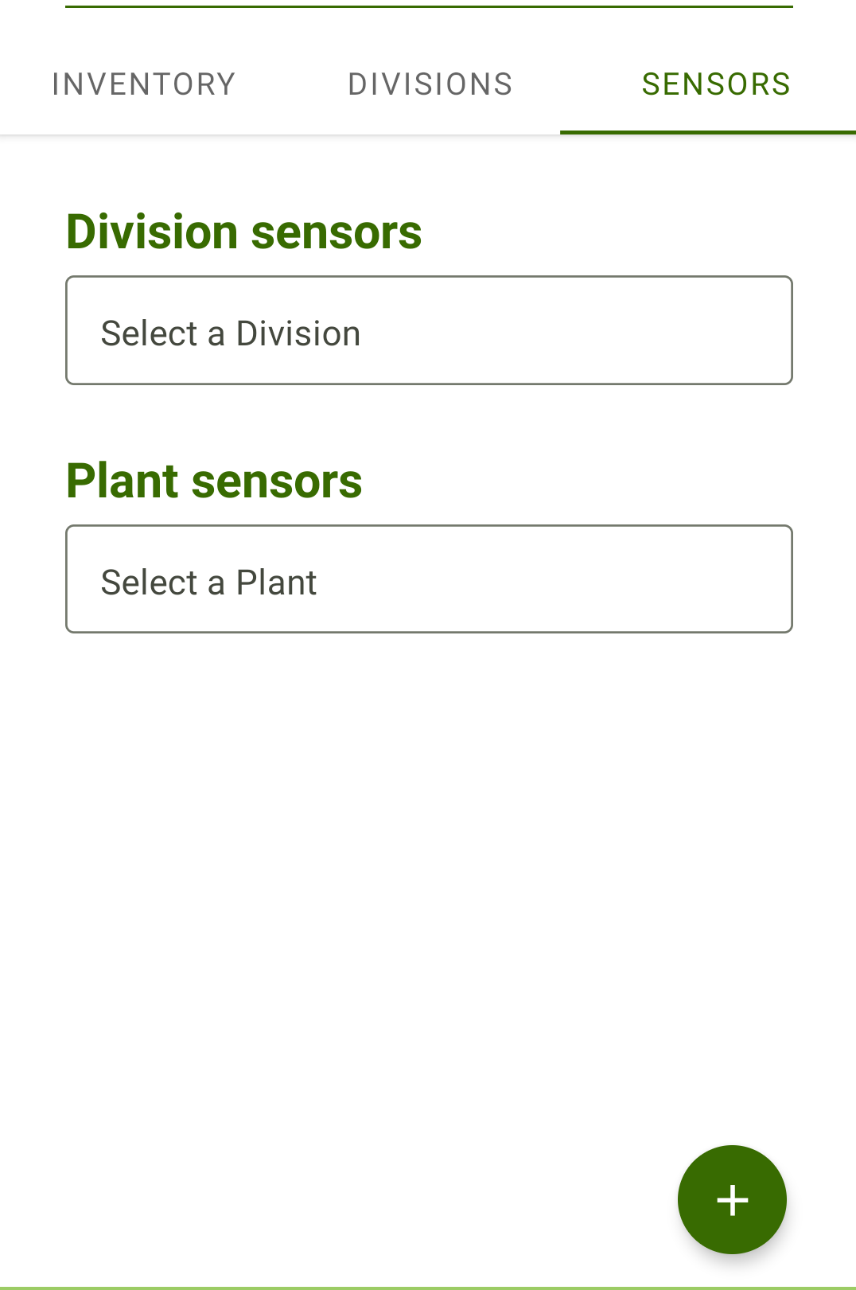
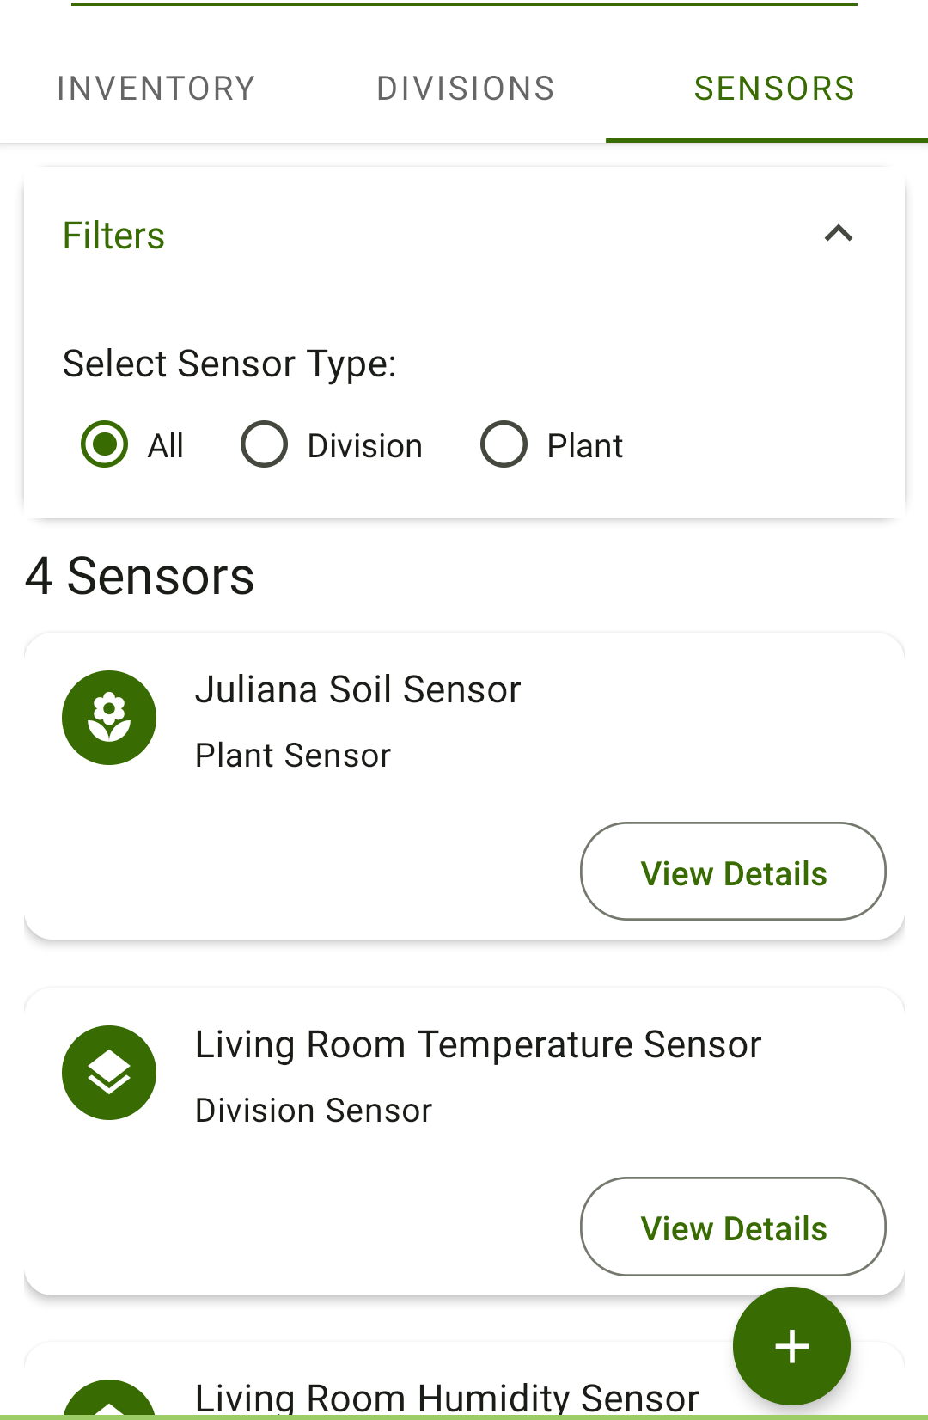
Feedback & Refactor
Sensor Inventory Page
Problem
Solution
20
Notes:
A outra alteração necessária foi ao nível do design da secção dos sensores na página inicial da aplicação. [click] Esta secção tinha alguns erros clássicos de design, nomeadamente não aparecer de imediato a informação dos sensores nem ser possível filtrar ou geri-los.

Slide 22
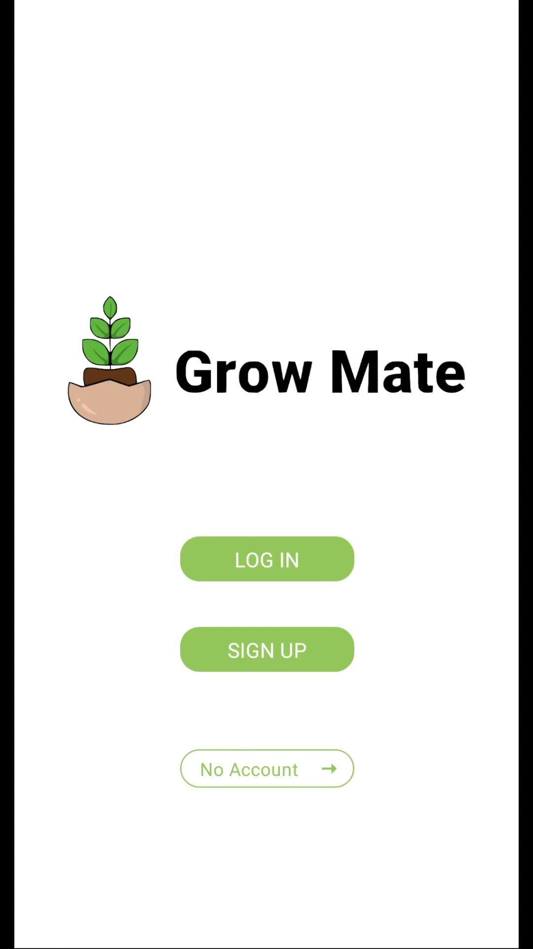
Achieved Results
21
Notes:
Apesar dos atrasos mencionados, fomos capazes de implementar as funcionalidades principais da aplicação. A abordagem inicial de prototipagem em papel e, posteriormente, em formato virtual permitiu-nos desenvolver uma interface gráfica atrativa e intuitiva que, no contexto móvel, representam requisitos extremamente cruciais.

Slide 23
Usability Tests

Slide 24

Usability Tests
Target market segment is very vast when it comes to age and technological knowledge – usability tests needed to ensure intuitiveness of the app
Tests composed by tasks identified from core use cases

Slide 25
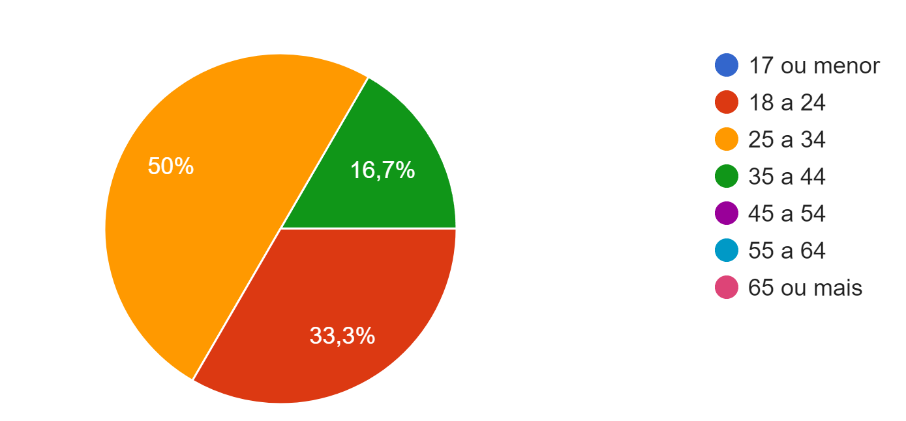
Usability Tests Results
7 people of various ages completed the tests
The app was considered intuitive and appealing
Implemented functionalities were praised
Question | Avg Answer*
The icons used were intuitive | 5.0
The existing information about each plant is enough for me to take good care of them | 4.5
The overall design of the application is nice | 4.3
It’s easy to understand what each screen and component does | 4.2
* Scale of 0-5, with 0 being “Strongly Disagree” and 5 being “Strongly Agree”
23

Slide 26
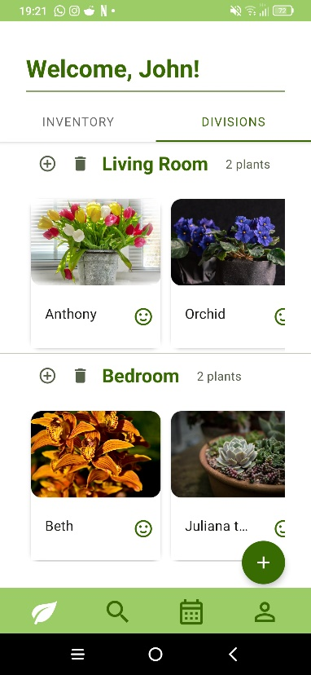
Usability Tests Results
Task: Moving a plant from one division to another
Users tried to drag the cards from one division to another
They took a long time to realize that the option was on the + button next to the division title
24

Slide 27
Conclusion

Slide 28

Goals
Inventory
App
Schedule
Plants inventory and
management
Mobile app implementation
Schedule of tasks for plant
maintenance
Ideas
Sensors
Tips
Suggestion of similar
plants
Integration of sensors
Optimal plant conditions
and suggestions
26

Slide 29
Lessons Learned
Set Realistic Expectations from the Start
Adapt to new circumstances
Implement an effective risk management plan
Ensure clear project management practices with well defined milestones and sprint objectives
27

Slide 30
Grow Mate

